Slide 1
Routing and Processing
Notes:
Welcome to the Routing and Processing module. In this section, we will explore advanced patterns that enhance the efficiency and effectiveness of message handling within distributed systems. Proper routing and processing are crucial for ensuring that messages reach the right destinations and are processed appropriately, thereby enabling seamless communication and coordination between different parts of your application.
By the end of this module, you will be equipped with practical knowledge and techniques to improve your messaging solutions, making them more efficient and reliable. Let’s dive in and explore how to take your message handling capabilities to the next level!

Slide 2
Routing and Processing
Pattern 1: Message Routing

Slide 3
What is Messaging Routing
Directs messages to different destinations based on specific criteria
Isolate problematic messages
Notes:
Definition
Messaging routing is a pattern that directs messages to different destinations based on specific criteria. This allows for flexible and dynamic handling of messages.
Purpose
It helps in organizing and managing message flows within a system, ensuring that messages reach the appropriate endpoints for processing.

Slide 4

Key Components & Flow
Message Router
Endpoint A
Endpoint B
Producer
Endpoint B
Consumer(s)
Endpoint A
Notes:
Message Producer
The component or service that creates and sends messages.
Message Router
The intermediary that evaluates messages and determines their destination based on predefined rules or criteria.
Destination Endpoints
The components or services that receive and process the routed messages.

Slide 5
Message Router
High Priority
Low Priority
Producer
Consumer
Low Priority
High Priority

Slide 6
Benefits
Flexibility
Scalability
Organization
Notes:
Flexibility: Enables dynamic routing of messages based on various criteria.
Scalability: Supports efficient distribution of messages to balance the load across multiple consumers or services.
Improved Organization: Helps in managing and organizing message flows within complex systems.

Slide 7
Drawbacks
Complexity
Overhead
Scalability
Notes:
Increased Complexity
Rule Management: Defining and managing routing rules can become complex, especially in dynamic environments where requirements frequently change. This complexity grows as the number of routing criteria and endpoints increases.
Configuration Overhead: Ensuring that all routing configurations are accurate and up-to-date requires significant effort and careful management. Misconfigurations can lead to incorrect routing, causing processing delays or errors.
Performance Overhead
Latency: Each routing decision adds processing time, which can introduce latency, particularly in high-throughput systems where quick message delivery is crucial.
Resource Consumption: The message router itself cane become a bottleneck if it is not adequately scaled or optimized, consuming considerable computational and network resources to process and route messages efficiently.
Scalability Challenges
Load Distribution: While routing helps balance load, ensuring that the message router scales effectively to handle varying loads can be challenging. If not properly managed, the router can become a single point of failure or performance bottleneck.
Reliability: Ensuring reliable message routing in a distributed system requires robust error handling and retry mechanisms. Any failure in the routing logic or in the router itself can disrupt the message flow, leading to potential data loss or processing delays.

Slide 8
Use Cases
Load Balancing
Content-Based Routing
Priority Routing
Notes:
Load Balancing
Distributing message to different servers or services based on load or capacity.
Content-Based Routing
Directing messages to different endpoints based on the content of the message.
Priority Routing
Routing messages based on their priority or urgency to ensure timely processing.

Slide 9
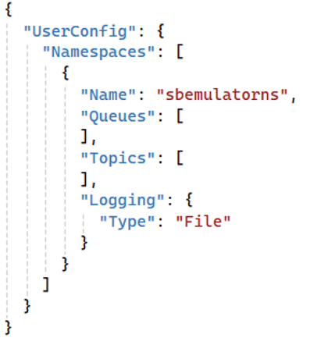
Demonstration
Create Namespace

Slide 10
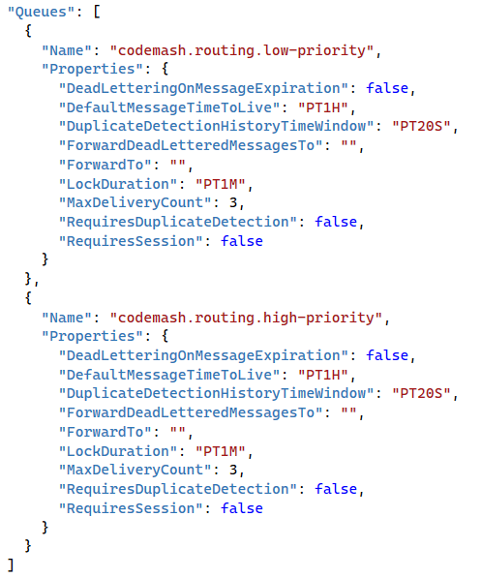
Demonstration
Create Namespace
Create the Message Queues

Slide 11
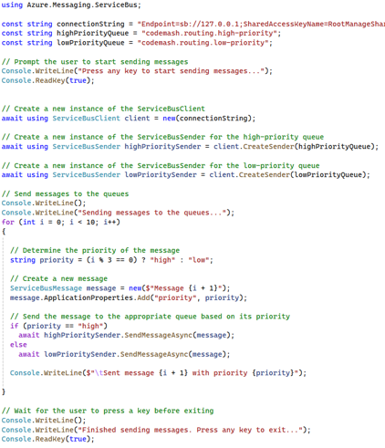
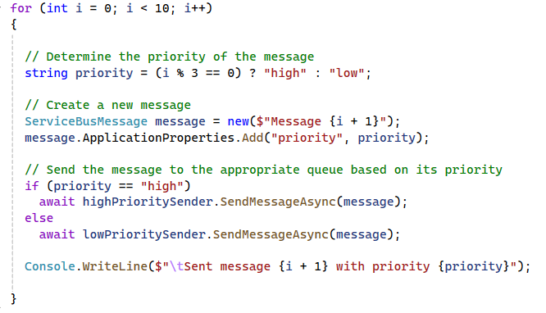
Demonstration
Create Namespace
Create the Message Queues
Create a Message Producer

Slide 12
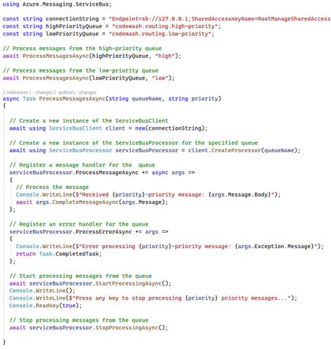
Demonstration
Create Namespace
Create the Message Queues
Create a Message Producer
Create a Message Consumer

Slide 13
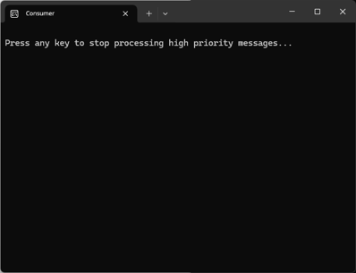
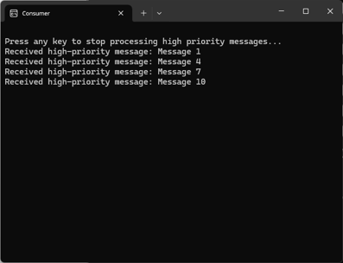
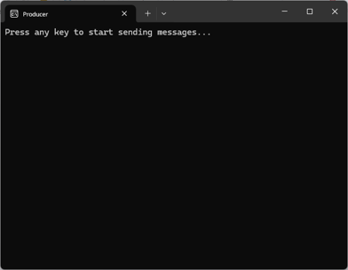
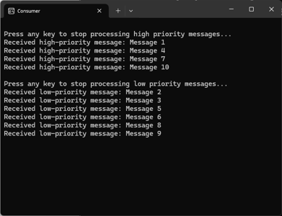
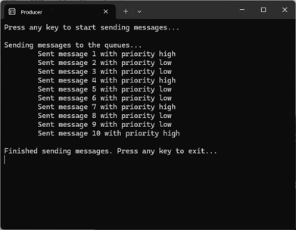
Demonstration
Create Namespace
Producer
Consumer
Create the Message Queues
Create a Message Producer
Create a Message Consumer
Run the Demo

Slide 14
Key Points to Remember
Supports flexible and dynamic routing of messages
Enhances system scalability and load balancing
Facilitates efficient organization and management of message flows

Slide 15
Routing and Processing
Pattern 2: Dead Letter Queues

Slide 16
What is Point-to-Point Messaging
Secondary queue of unprocessable messages
Isolate problematic messages
Notes:
Definition
A Dead Letter Queue is a secondary queue used to hold messages that cannot be processed successfully. These messages are typically moved to the Dead Letter Queue after several failed processing attempts or when they exceed their time-to-live (TTL).
Purpose
Dead Letter Queues help in isolating problematic messages, allowing for troubleshooting and analysis without affecting the normal message flow.

Slide 17
Key Components & Flow
Message Broker
Producer
Consumer
Message Queue
Dead Letter Queue
Notes:
Message Queue
The main queue where message are initially sent and processed.
Message Producer (Sender)
The component or service that creates and sends message to the primary queue.
Message Consumer (Receiver)
The component or service that processes messages from the primary queue and moves failed messages to the Dead Letter Queue
Message Broker
An optional intermediary that manages the primary and dead letter queues, ensuring messages are properly routed.
Dead Letter Queue
The secondary queue where failed messages are moved after processing attempts fail.

Slide 18
Benefits
Reliability
Troubleshooting
Efficiency
Notes:
Improved Reliability: Ensures that problematic messages do not block the message processing pipeline.
Simplified Troubleshooting: Provides a clear location to analyze and debug failed messages.
Operational Efficiency: Allows normal message processing to continue without interruption.

Slide 19
Drawbacks?
Complexity
Delayed Processing
Data Loss Potential
Notes:
Increased Complexity
Management Overhead: Handling Dead Letter Queues adds complexity to the system. Developers need to implement logic to manage failed messages and ensure they are moved to the Dead Letter Queue appropriately.
Monitoring and Maintenance: Regular monitoring and maintenance of Dead Letter Queues are required to ensure they do not get overloaded or ignored. This adds an additional layer of operational overhead.
Delayed Processing
Resolution Time: Messages in the Dead Letter Queue are not processed until they are manually inspected and resolved. This can lead to significant delays in addressing the issues, especially if the Dead Letter Queue is not monitored regularly.
Resource Allocation: Allocating resources for monitoring and processing Dead Letter Queues can impact the system’s overall efficiency, as resources could be tied up dealing with problematic messages instead of handling regular operations.
Potential for Data Loss
Misconfiguration Risks: Incorrect configuration or improper handling of Dead Lead Queues can lead to data loss. For example, if message are moved to the Dead Letter Queue without proper logging or tracking, they may be overlooked and not processed.
Manual Intervention Dependency: Since Dead Letter Queues often require manual intervention to resolve issues. There is a risk of human error or oversight, which could result in important messages being lost of forgotten.

Slide 20
Use Cases
Error Handling
Message Expiry
Monitoring & Troubleshooting
Notes:
Error Handling
Capturing messages that cannot be processed due to errors such as format issues or missing data.
Message Expiry
Handling messages that have exceeded their TTL without being processed.
Monitoring and Troubleshooting
Analyzing message in the Dead Letter Queue to identify patterns and root causes of failures.

Slide 21
Demonstration
Create Namespace

Slide 22
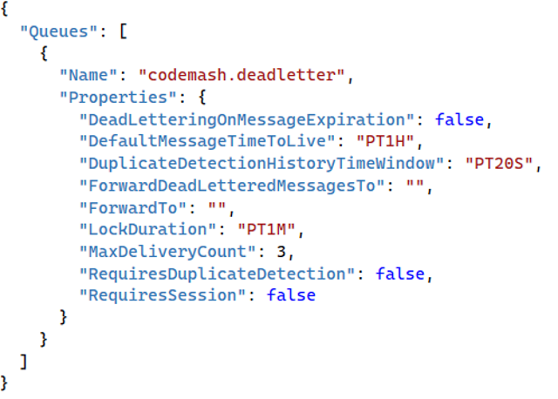
Demonstration
Create Namespace
Create the Message Queue

Slide 23
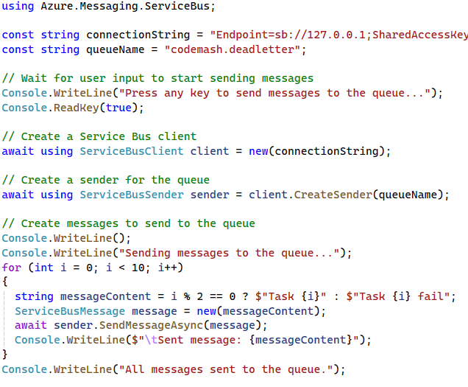
Demonstration
Create Namespace
Create the Message Queue
Create a Message Producer

Slide 24
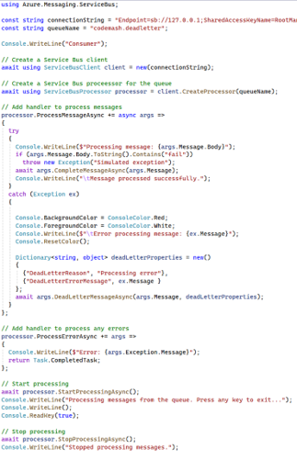
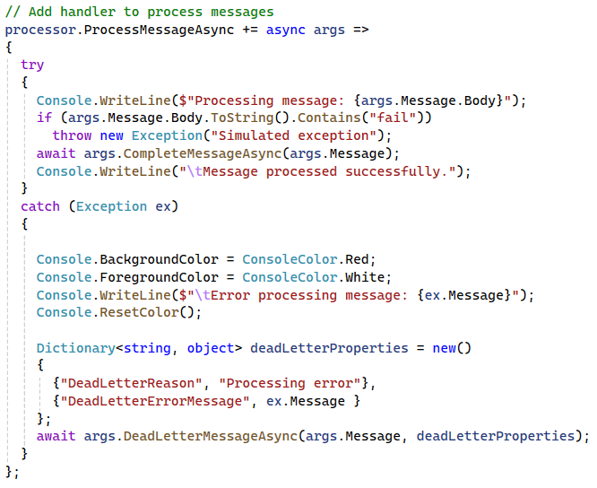
Demonstration
Create Namespace
Create the Message Queue
Create a Message Producer
Create a Message Consumer

Slide 25
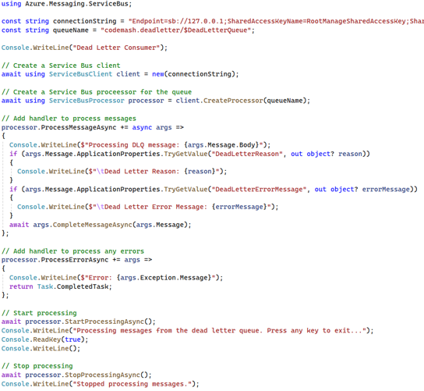
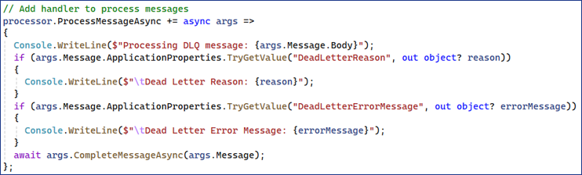
Demonstration
Create Namespace
Create the Message Queue
Create a Message Producer
Create a Message Consumer
Create a DLQ Consumer

Slide 26
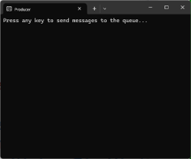
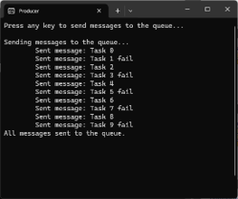
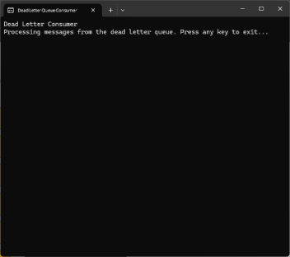
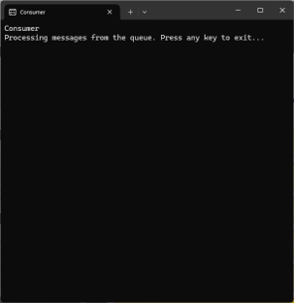
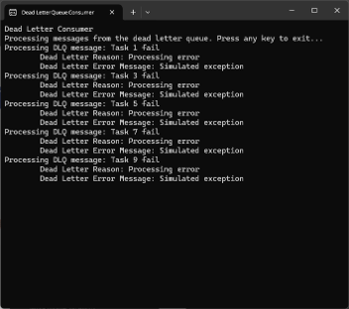
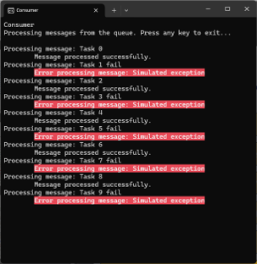
Demonstration
Producer
Create Namespace
Create the Message Queue
Create a Message Producer
Consumer
DLQ Consumer
Create a Message Consumer
Create a DLQ Consumer
Run the Demo

Slide 27
Key Points to Remember
Helps in isolating and handling problematic messages
Facilitates troubleshooting and improves system reliability
Ensures that normal message processing continues without distruption

Slide 28
Routing and Processing
Pattern 3: Message Filtering

Slide 29
What is Messaging Filtering
Consumers selectively receive messages based on criteria or filters
Route message to appropriate consumers
Notes:
Definition
Messaging filtering is a pattern that allows consumers to selectively receive messages based on specific criteria or filters. This enables more efficient and targeted message processing.
Purpose
It helps in directing relevant messages to the appropriate consumers, reducing the overhead of processing irrelevant messages.

Slide 30
Key Components & Flow
Subscriptions
Message Router
Subscription A
Topic
Subscription B
Producer
Consumers
Subscription B
Subscription A
Notes:
Message Producer
The component or service that creates and sends messages.
Message Filter
The intermediary that evaluates messages and determines whether they meet the criteria for delivery to specific consumers.
Filtered Consumers
The components or services that receive and process messages that match their filter criteria.

Slide 31
Benefits
Efficiency
Scalability
Flexibility
Notes:
Efficiency: Reduces the processing load on consumers by filtering out irrelevant messages.
Scalability: Supports targeted message delivery, which can improve overall system performance.
Flexibility: Enables consumers to dynamically adjust their subscriptions and filters based on changing requirements.

Slide 32
Drawbacks
Complexity
Overhead
Scalability
Notes:
Complexity in Filter Management
Rule Configuration: Defining and maintaining filtering rules can become complex, especially in systems with a large number of filters or rapidly changing requirements. As filters grow in number and complexity, managing them effectively can be challenging.
Dynamic Adjustments: Adjusting filters dynamically based on changing needs requires sophisticated logic and careful management to ensure that relevant messages are not missed.
Performance Overhead
Processing Load: Evaluating each message against multiple filters can introduce performance overhead. In high-throughput systems, this additional processing can lead to increased latency and reduced overall system performance.
Resource Utilization: The filter process consumers computational resources which can impact the performance of other system components, especially when dealing with large volumes of message.
Scalability Challenges
Filter Scalability: Scaling the filtering mechanism to handle a high number of filters and large volumes of messages can be difficult. Ensuring that the filtering system can scale efficiently while maintaining performance is crucial.
Distributed Filtering: In distributed systems, ensuring consistent and synchronized filtering across multiple nodes or services can add complexity and post scalability challenges.

Slide 33
Use Cases
Subscription Filtering
Data Segmentation
Notification Systems
Notes:
Subscription Filtering
Allowing consumers to subscribe to only the messages they are interested in,. Based on attributes like type, priority, or content.
Data Segmentation
Directing specific types of data to different processing pipelines, such as separating financial transactions from other types of messages.
Notification Systems
Sending notifications to users based on their preferences or subscriptions.

Slide 34
Demonstration
Create Namespace

Slide 35
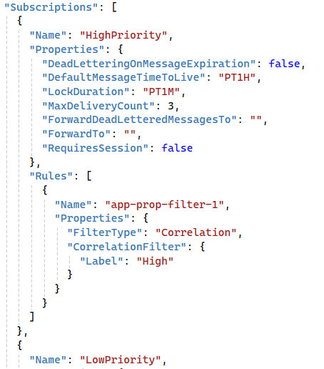
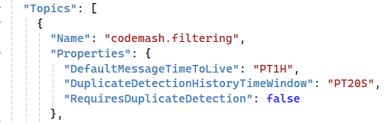
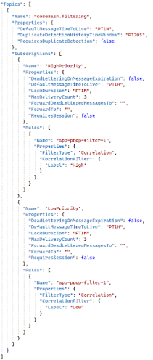
Demonstration
Create Namespace
Create Topic & Subscriptions

Slide 36
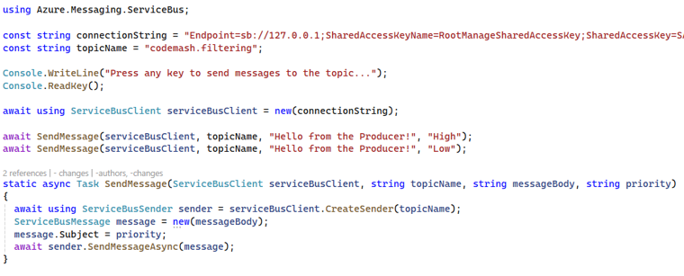
Demonstration
Create Namespace
Create Topic & Subscriptions
Create a Message Producer

Slide 37
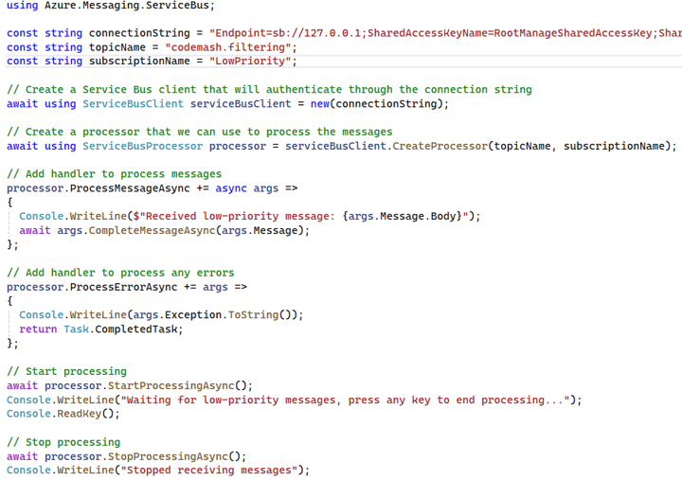
Demonstration
Create Namespace
Create Topic & Subscriptions
Create a Message Producer
Create the Message Consumers

Slide 38
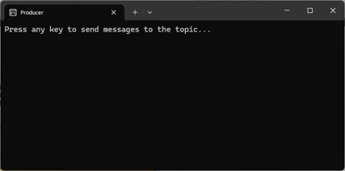
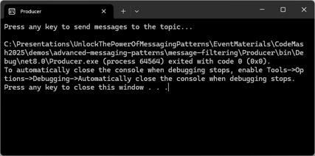
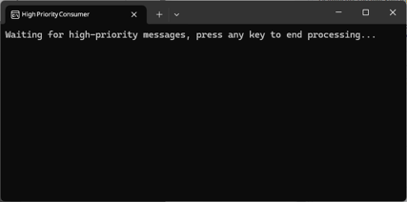
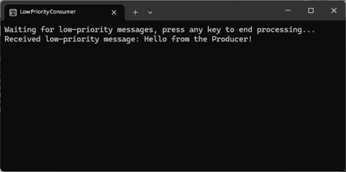
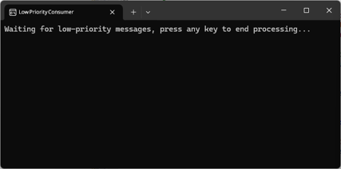
Demonstration
Producer
Create Namespace
Create Topic & Subscriptions
Create a Message Producer
High-Priority Consumer
Create the Message Consumers
Run the Demo
Low-Priority Consumer

Slide 39
Key Points to Remember
Supports selective message delivery based on specific criteria
Enhances efficiency and scalability of message processing
Provides flexibility for consumers to adjust their subscription and filters

Slide 40
Routing and Processing
Pattern 4: Aggregator Pattern

Slide 41
What is the Aggregator Pattern
Multiple message collected and processed as a single unit
Aggregate related information for various sources
Notes:
Definition
The Aggregator Pattern is a messaging pattern where multiple message are collected and processed as a single unit. This allows for batch processing and consideration of data from different sources.
Purpose
It helps in aggregating related information from various sources and presenting it as a unified, cohesive output.

Slide 42
Key Components & Flow
Input
Output
Consumer
Aggregator
Producers
Notes:
Message Producers (Senders)
Components or services that create and send individual messages to be aggregated.
Aggregator
The intermediary that collects and processes multiple messages, combining them into a single output.
Aggregated Output
The final, consolidated output that results from aggregating the individual messages.

Slide 43
Benefits
Efficiency
Unified View
Scalability
Notes:
Efficiency: Reduces the overhead of processing individual messages by handling them in batches.
Unified View: Provides a consolidated view of related information, simplifying analysis and decision-making.
Scalability: Supports scalable processing of large volumes of messages by aggregating them into manageable units.

Slide 44
Drawbacks
Latency
Complexity
Resource Utilization
Notes:
Increased Latency
Delayed Processing: Since the aggregator waits to collect multiple message before processing them, there can be a delay in processing individual messages. This latency can be problematic for time-sensitive applications that require immediate processing of each message.
Batch Waiting Time: The aggregator might have to wait until it receives enough messages to form a batch, which can introduce further delays, especially if messages arrive sporadically or unevenly.
Complexity in Implementation and Management
Aggregation Logic: Implementing the logic to collect, combine, and process multiple messages can be complex. It requires careful design to ensure that the aggregation process is efficient and handles edge cases, such as missing or duplicate messages.
State Management: The aggregator needs to manage the state of partial aggregations, which adds to the complexity. This involves tracking which messages have been received, handling timeouts, and ensuring data consistency.
Resource Utilization
Memory and Storage: The aggregator needs to store all the incoming message until they are processed, which can consume significant memory and storage resources, especially when dealing with large volumes of messages.
Processing Overhead: Aggregating and processing multiple messages as a single unit can increase the computation load. This processing overhead can impact the performance and scalability of the system if not managed properly.

Slide 45
Use Cases
Batch Processing
Data Consolidation
Event Correlation
Notes:
Batch Processing
Collecting and processing multiple messages in a single batch to improve efficiency.
Data Consolidation
Aggregating data form different sources for reporting, analysis, or storage.
Event Correlation
Combining related events form different systems to provide a comprehensive view of a process or transaction.

Slide 46
Demonstration
Create Namespace

Slide 47
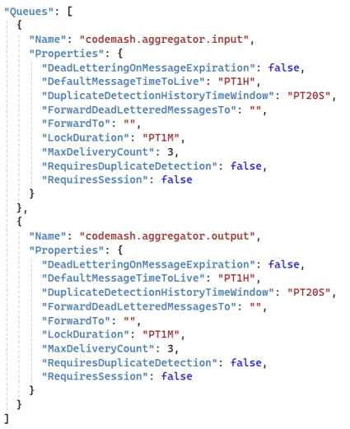
Demonstration
Create Namespace
Create the Queues

Slide 48
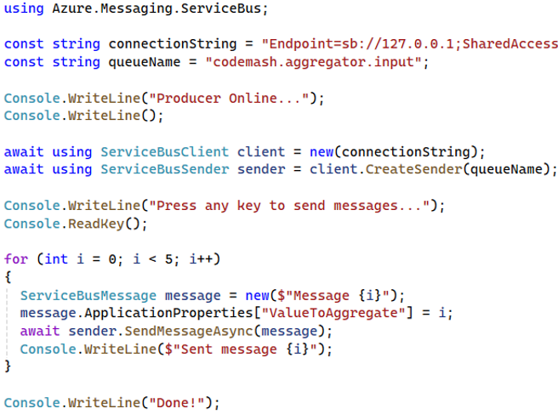
Demonstration
Create Namespace
Create the Queues
Create the Producer

Slide 49
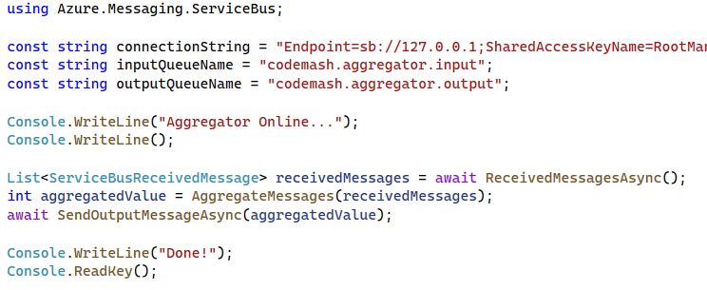
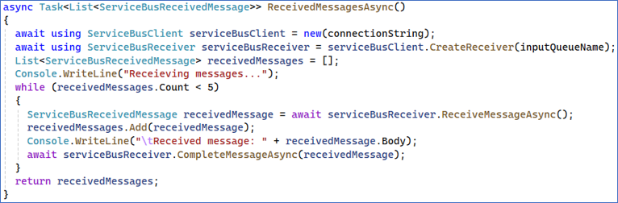
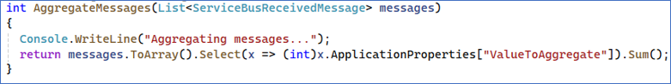
Demonstration
Create Namespace
Create the Queues
Create the Producer
Create the Aggregator

Slide 50
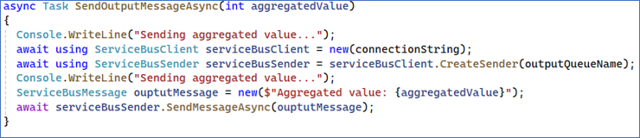
Demonstration
Create Namespace
Create the Queues
Create the Producer
Create the Aggregator

Slide 51
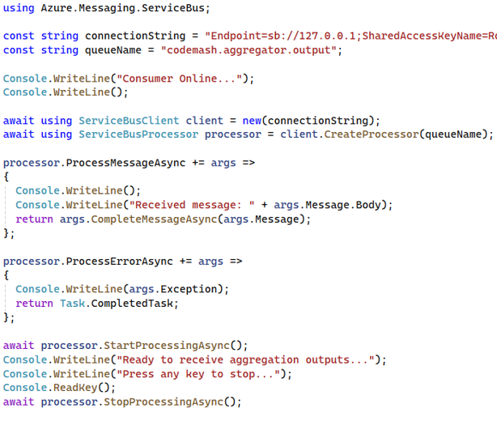
Demonstration
Create Namespace
Create the Queues
Create the Producer
Create the Aggregator
Create the Consumer

Slide 52
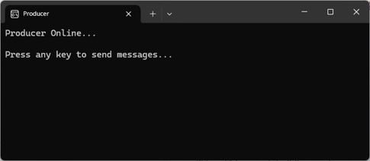
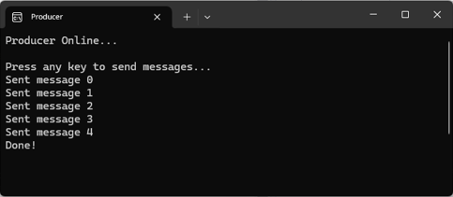
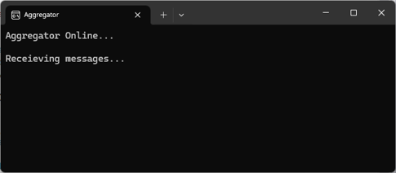
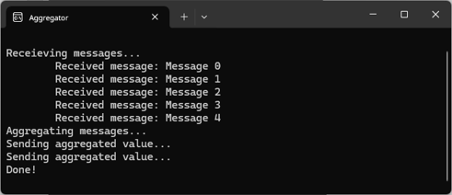
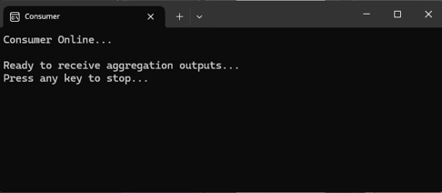
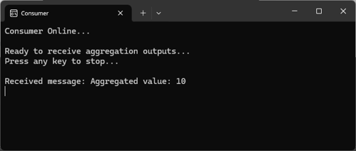
Demonstration
Producer
Create Namespace
Create the Queues
Create the Producer
Aggregator
Create the Aggregator
Create the Consumer
Run the Demo
Consumer

Slide 53
Key Points to Remember
Aggregates related messages for batch processing and data consolidation
Enhances efficiency and scalability by reducing the overhead of processing individual messages
Provides a unified view of related information, simplifying analysis and decision-making

Slide 54
Routing and Processing
Pattern 5: Scatter-Gather Pattern

Slide 55
What is the Scatter-Gather Pattern
Request sent to multiple recipients and responses are aggregated
Parallel processing and aggregation of results
Notes:
Definition
The Scatter-Gather Pattern is a messaging pattern where a request is sent to multiple recipients (scatter), and the responses are collected and processed (gather) to produce a final aggregated result.
Think like a loan broker service
Purpose
It enables parallel processing and aggregation of results from multiple services or components, improving efficiency and performance.

Slide 56
Key Components
Requester
Scattered Recipients
Gatherer
Component or service that initiates the scatter request and waits for the gathered responses.
Multiple components or services that receive the scatter request and process it in parallel.
The component or service that collects the responses from the scattered recipients, aggregates them, and produces the final result.
Notes:
Requester
The component or service that initiates the scatter request and waits for the gathered responses.
Scattered Recipients
Multiple components or services that receive the scatter request and process it in parallel.
Gatherer
The component or service that collects the responses from the scattered recipients, aggregates them, and produces the final result.

Slide 57

Flow
Requester
Scattered Recipients
Gatherer
Notes:
Requester
The component or service that initiates the scatter request and waits for the gathered responses.
Scattered Recipients
Multiple components or services that receive the scatter request and process it in parallel.
Gatherer
The component or service that collects the responses from the scattered recipients, aggregates them, and produces the final result.

Slide 58
Benefits
Efficiency
Scalability
Resilience
Notes:
Efficiency: Improves overall system efficiency by leveraging parallel processing.
Scalability: Supports scalable processing by distributing tasks across multiple services.
Resilience: Enhances system resilience by allowing multiple services to contribute to the final result, reducing the impact of individual service failures.

Slide 59
Drawbacks
Complexity
Latency
Scalability
Notes:
Complexity in Implementation and Coordination
Orchestration: Coordinating the scattering of requests and the gathering of responses requires careful orchestration. It can be complex to manage the synchronization of responses handle partial failures, and ensure consistency.
Error Handling: Dealing with errors and timeouts from scattered recipients adds to the complexity. Implementing robust error handling and retry mechanisms is crucial to ensure reliable processing.
Latency and Performance Overhead
Response Time: The overall response time is dependent on the slowest recipient. If any of the scattered recipients tak longer to process the request, it can delay the final aggregated result.
Network and Resource Utilization: The scattering of requests to multiple recipients can introduce network overhead and increase resource consumption. This can impact the performance and scalability of the system.
Scalability Challenges
Load Management: Ensuring that the scattered recipients can handle the distributed load effectively is crucial. It not properly managed, some recipients might become overloaded, leading to performance degradation or failures.
Data Consistency: Maintaining data consistency across multiple scattered recipients can be challenging. Ensuring that all resources are accurately collected and aggregated requires careful design and implementation.

Slide 60
Use Cases
Parallel Processing
Data Aggregation
Load Balancing
Notes:
Parallel Processing
Distributing tasks to multiple services or components for parallel execution, such as querying different databases or performing computations.
Data Aggregation
Collecting and consolidating results from multiple sources to provide a comprehensive view, such as aggregating search results or financial results.
Load Balancing
Distributing workload across multiple services to balance the load and improve system performance.

Slide 61
Demonstration
Create Namespace

Slide 62
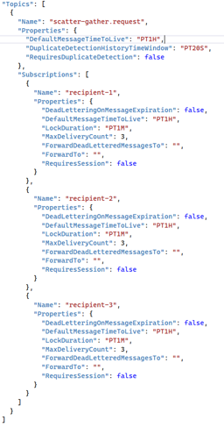
Demonstration
Create Namespace
Create Topic & Subscriptions

Slide 63
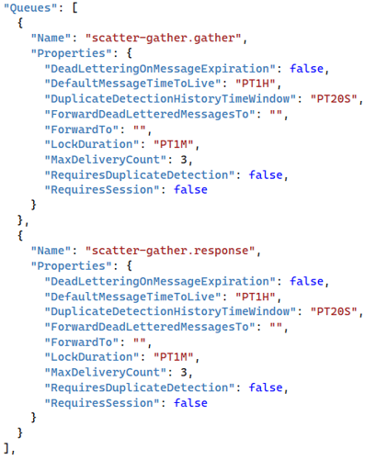
Demonstration
Create Namespace
Create Topic & Subscriptions
Create Queues

Slide 64
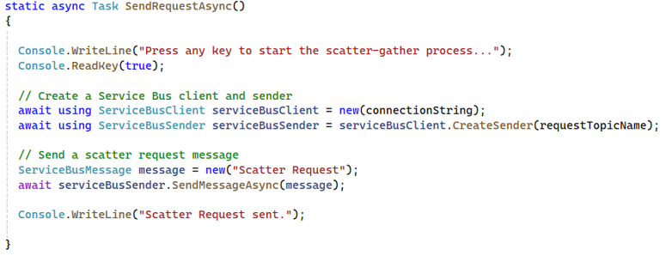
Demonstration
Create Namespace
Create Topic & Subscriptions
Create Queues
Create Requester
Notes:
SendRequestAsync – Common Helper

Slide 65
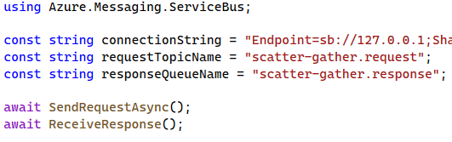
Documentation
Create Namespace
Create Topic & Subscriptions
Create Queues
Create Requester

Slide 66
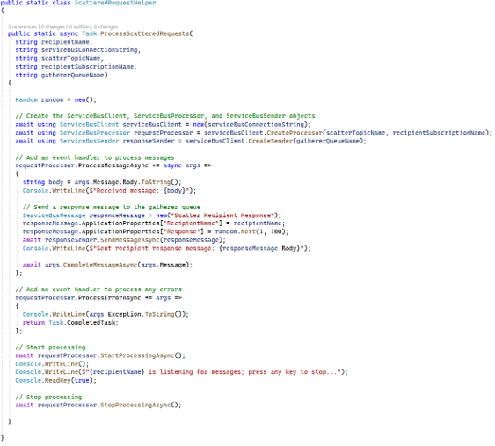


Demonstration
Create Namespace
Create Topic & Subscriptions
Create Queues
Create Requester
Create Recipients
Notes:
ScatteredRecipientHelper

Slide 67



Demonstration
Create Namespace
Create Topic & Subscriptions
Create Queues
Create Requester
Create Recipients

Slide 68
Demonstration
Create Namespace
Create Topic & Subscriptions
Create Queues
Create Requester
Create Recipients
Run the Demo

Slide 69











Requester
Recipients
Gatherer

Slide 70
Key Points to Remember
Aggregates related messages for batch processing and data consolidation.
Enhances efficiency and scalability by reducing the overhead of processing individual messages.
Provides a unified view of related information, simplifying analysis and decision-making.

Slide 71
Routing & Processing
Wrap Up

Slide 72
Routing & Processing Wrap-Up
Messaging Routing
Dead Letter Queues
Message Filtering
Aggregator
Scatter-Gather
Notes:
As we conclude the Routing and Processing module, let’s take a moment to reflect on what we have learned and preview what is coming next.
Messaging Routing: Understating how to direct message to appropriate endpoints.
Dead Letter Queue: Strategies for handling underivable messages.
Message Filtering: Techniques to process only the messages that matter.
Aggregator Pattern: Combining multiple related messages into a single message.
Scatter-Gather: Splitting messages into sub-messages and reassembling the responses.
These patterns have equipped you with the essential tools to enhance the efficiency and reliability of your messaging solutions.

Slide 73
Preview of What’s Next in the Workshop
Messaging Essentials
Core Messaging Patterns
Routing & Processing
Advanced Processing Techniques
Resilience & Reliability
Streaming & Integrations
Data Considerations
Hands-On Exercises

Slide 74
Preview of What’s Next in the Workshop
Advanced Processing Techniques
Idempotent Receiver
Messaging Scheduling
Claim Check
Notes:
In the next module, we will look into more sophisticated techniques to ensure robust messaging. Here is what to look forward to:
Idempotent Receiver: Ensuring messages are processed safely multiple times.
Message Scheduling: Delaying message processing until the right moment.
Transactional Queues: Guaranteeing message integrity within transactions.
Claim Check: Offloading large messages from the queue efficiently.
These advanced techniques will further strengthen your ability to design and implement scalable messaging solutions. Stay tuned as we continue our journey into the world of messaging patterns!

